Slide 1
Lecture 6
Thursday, February 2
The Environment

Slide 2
The Scope of Environmental Problems:
Somewhere between crisis & catastrophe

Slide 3
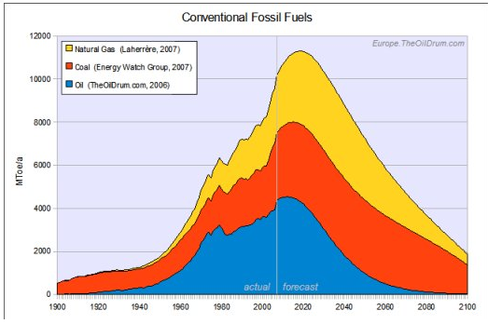
actual
(to 2007)
forecast

Slide 4
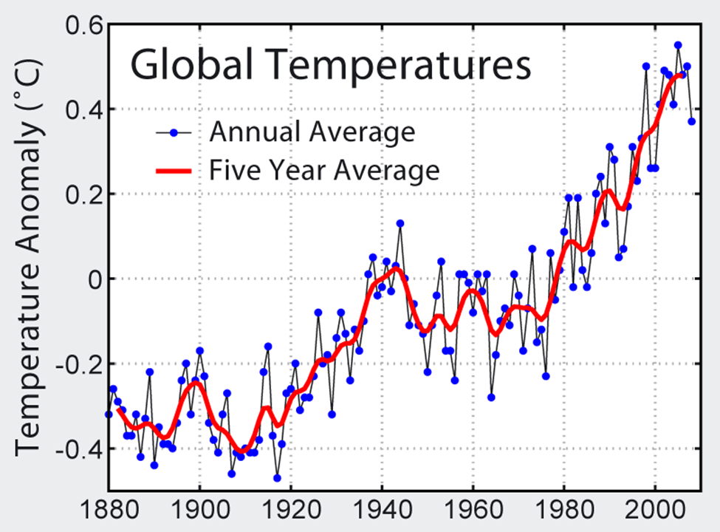
Long-term average

Slide 5
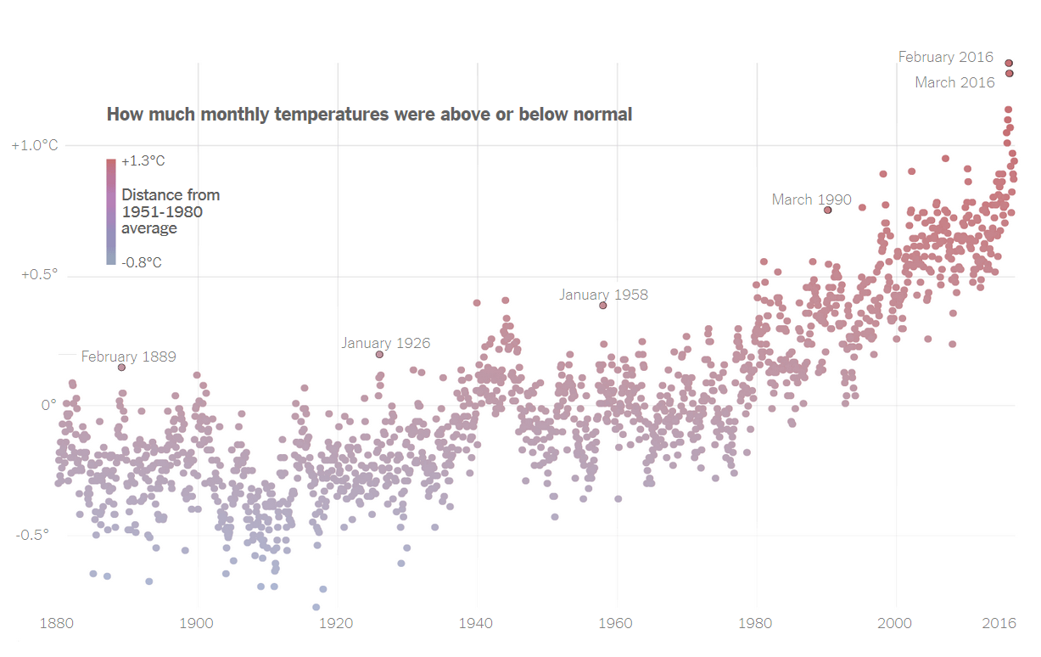
NYT Jan. 18, 2017

Slide 6
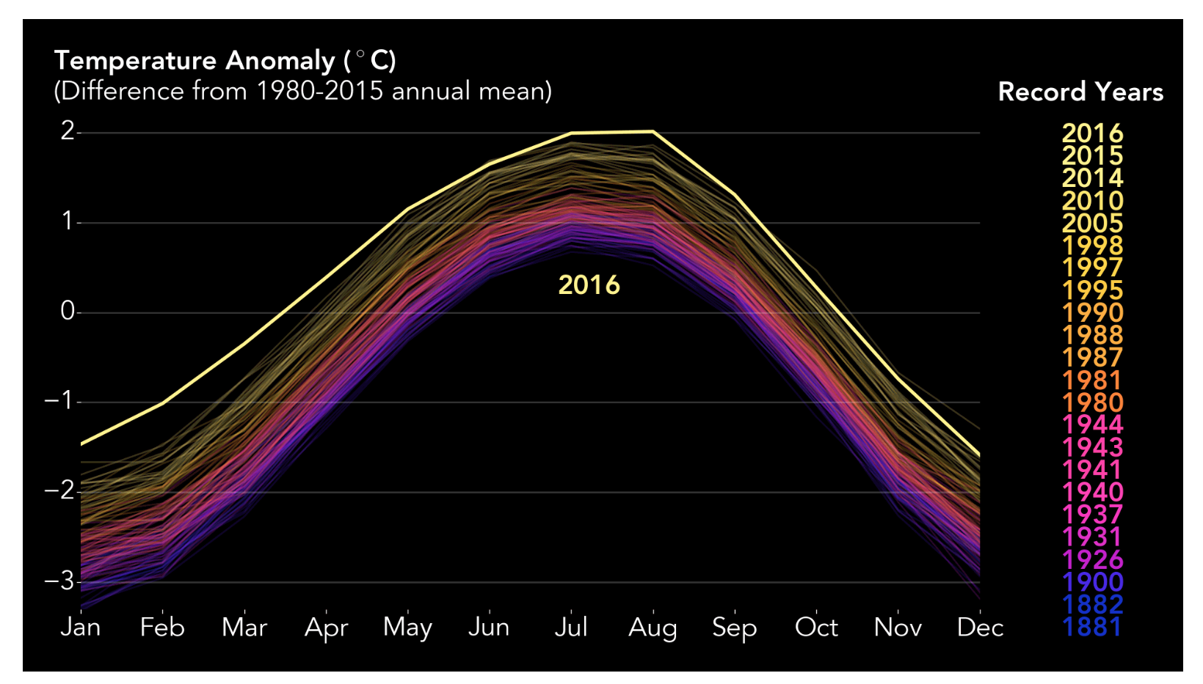
Image via NASA/Joshua Stevens, Earth Observatory

Slide 7
Historical observations
Scenarios for the future
Highest pathway: no change in current emissions patterns
Temperature Change (F°) relative to 1901-1960 average
Lowest pathway: immediate and rapid change in emissions

Slide 8
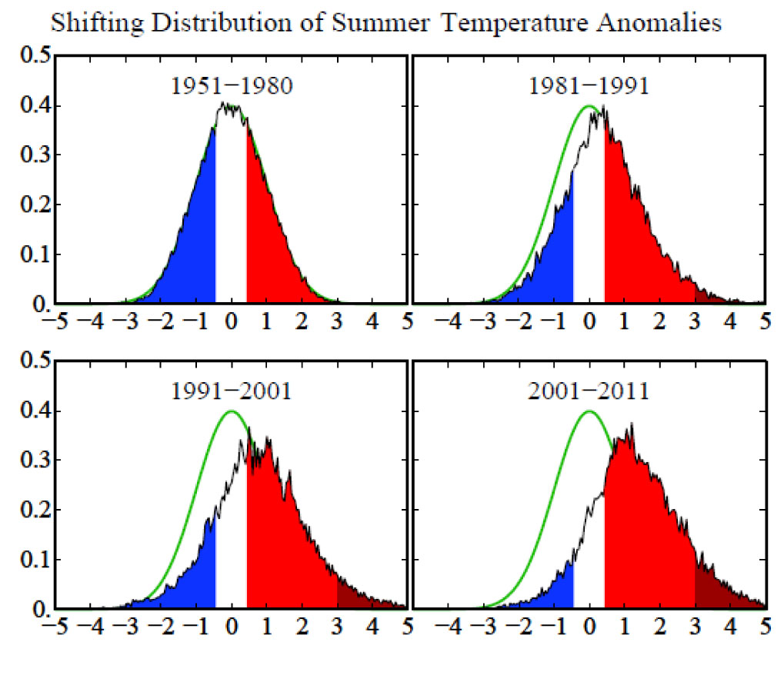
Frequency of summer temperature anomalies (how often they deviated from the historical normal of 1951-1980) over the summer months in the northern hemisphere. Source: NASA/ Hansen et al. 2012 http://climatecrocks.com/2012/08/05/hansen-on-the-new-math-of-extreme-events/

Slide 9
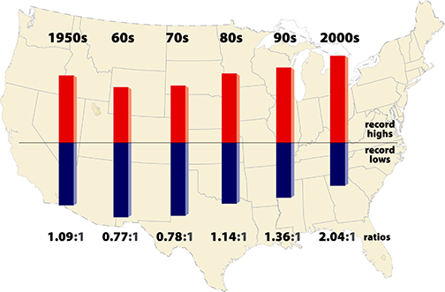
U.S. daily temperature extremes
2010 2011 2012
2.3:1 2.7:1 9.0:1
The ratio of record daily highs (red) to record daily lows (blue) at about 1,800 weather stations in the 48 contiguous United States from Jan. 1950 to Sept. 2009. Meehl et al. GRL 2009.
Update using NOAA data: Climatecommunication.org

Slide 10
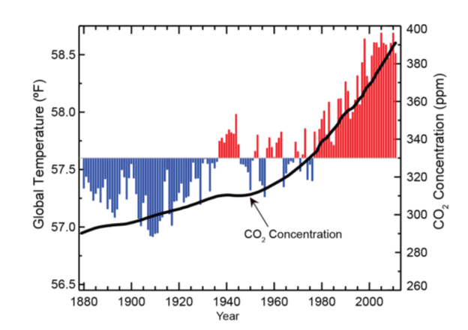
Global temperature and carbon dioxide

Slide 11
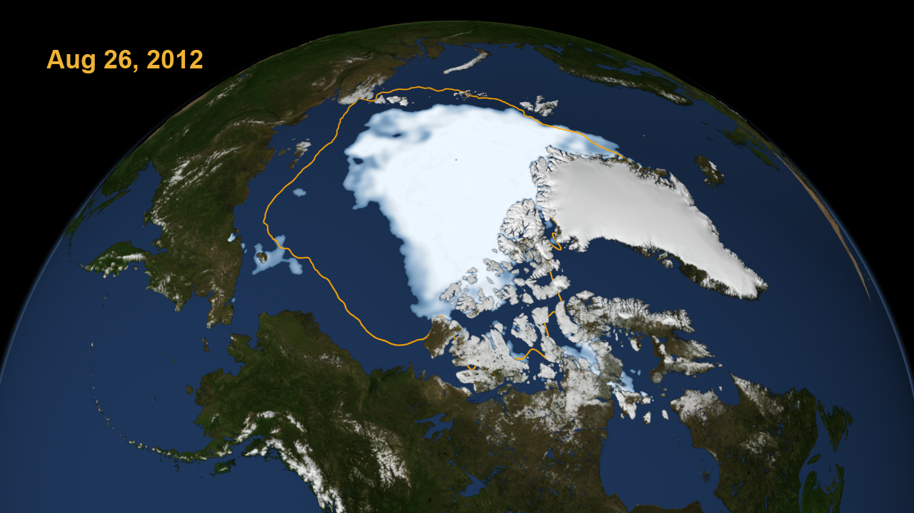
19 September 2012
Press Release: Arctic sea ice reaches lowest extent for the year and the satellite record

Slide 12
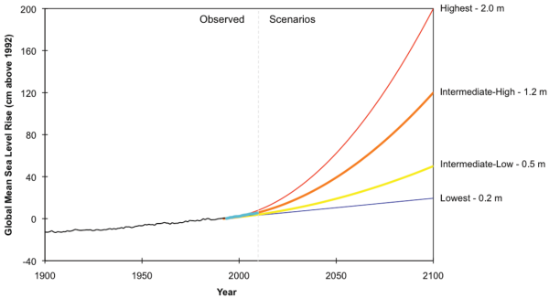
Sea-Level Rise scenarios for the U.S.

Slide 13
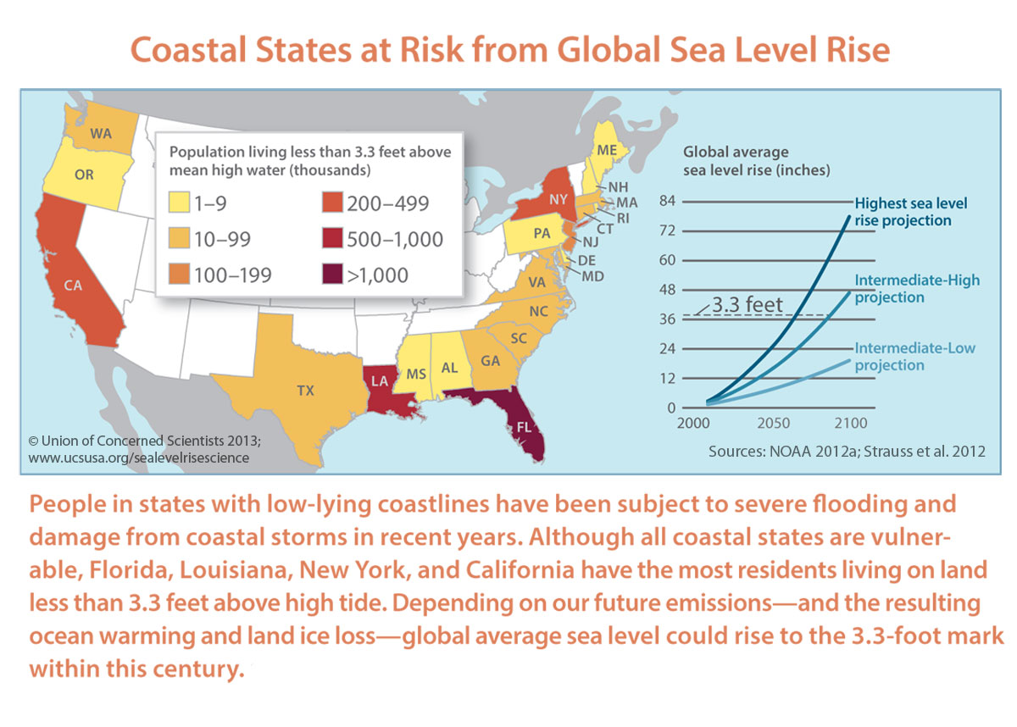

Slide 14
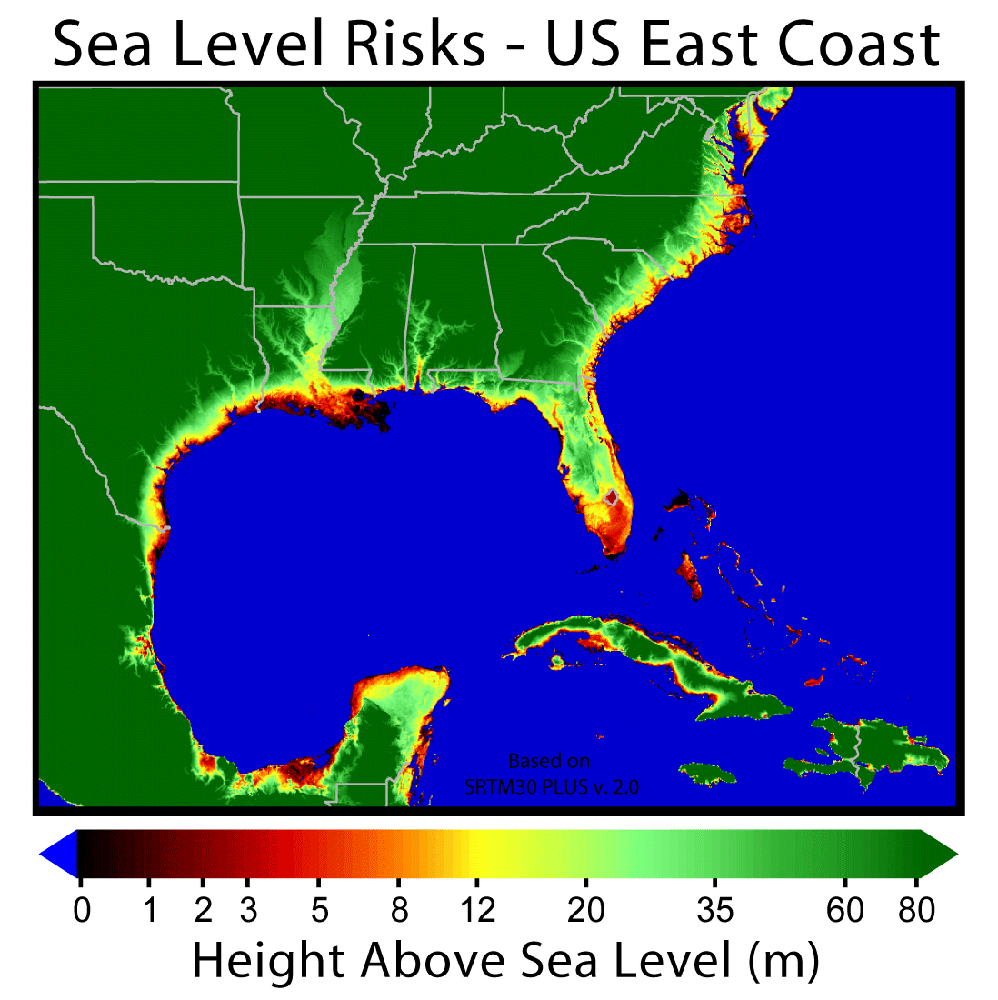

Slide 15
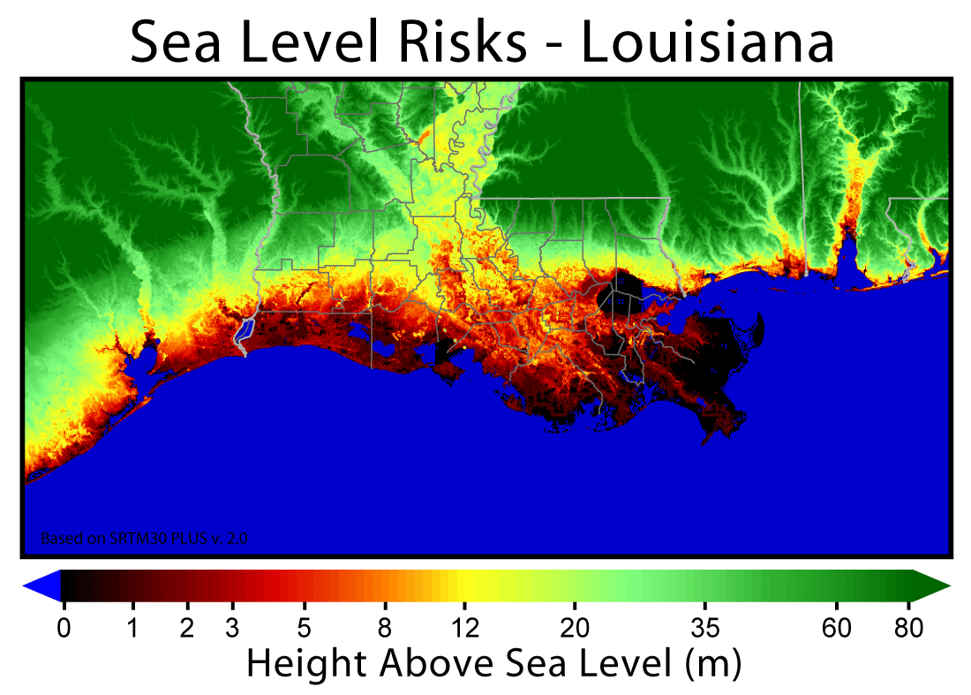

Slide 16
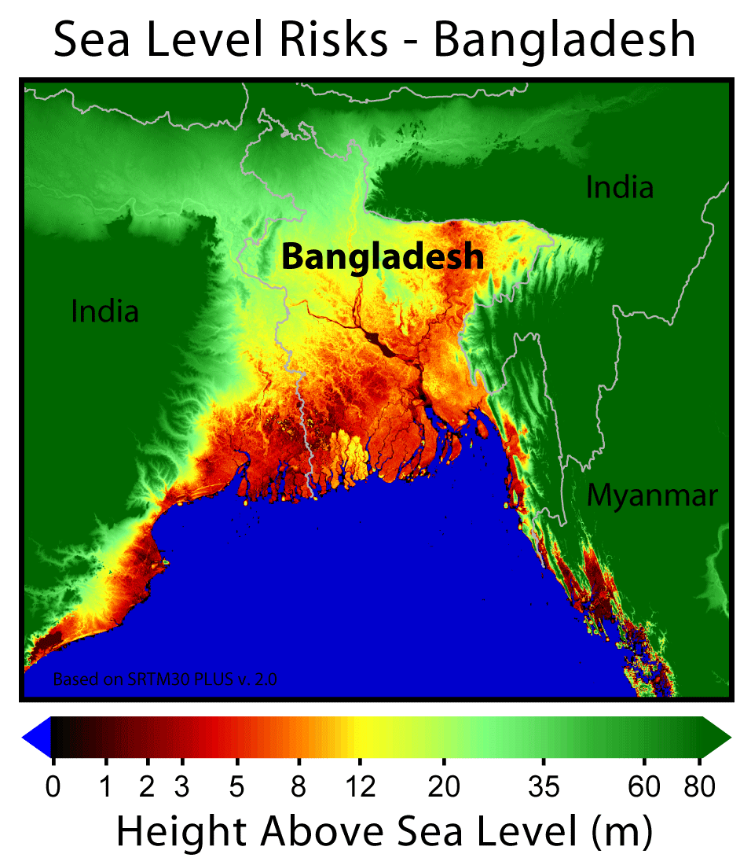

Slide 17
Five explanations for
environmental problems
I. Individual lack of concern for the environment & free-riding
II. Negative externalities of private choices and profit-making firms
III. Strategies of powerful actors
IV. consumerism run amok
V. Free market ideology blocks solutions.

Slide 18
Individual lack of concern for the environment & free-riding

Slide 19
Example of Environmental problem from individual free-riding
 |  |  | Your Choice
 |  |  | Recyle | Don’t recycle
Everyone else’s choice |  | Recycle | $50 A | $100 B
 |  | Don’t Recycle | -$50 C | $0 D
Individual annual cost of recycling = $50
Individual long-term benefit from recycling = $100

Slide 20
Solutions to environmental free-riding?
Notes:
Mandatory recycling
Mandatory fuel efficiency standards
Incentives for insulation, solar panels, electric cars: eliminate the free-rider bonus

Slide 21
II. Negative externalities of private choices and profit-making firms

Slide 22
Inter-generational
negative externality:
Displacing costs onto future generations

Slide 23
Energy Use in the USA and elsewhere, 2012

Slide 24
CO2 emissions per capita, 2012

Slide 25
NIMBY externalities:
Displacing costs onto the powerless

Slide 26
Census tracks in California by cancer risk from toxins in the air
70%
60%
White
Nonwhite
50%
40%
30%
20%
10%
0%
Lowest third of risk
highest third of risk

Slide 27
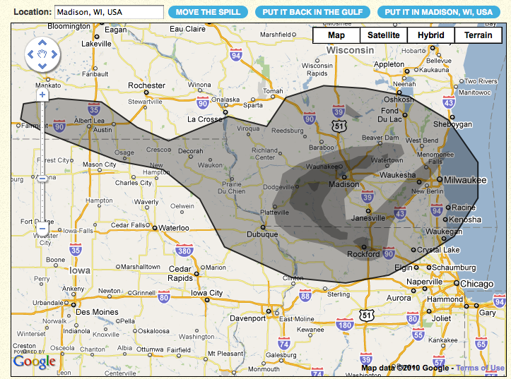
BP Oil Spill

Slide 28
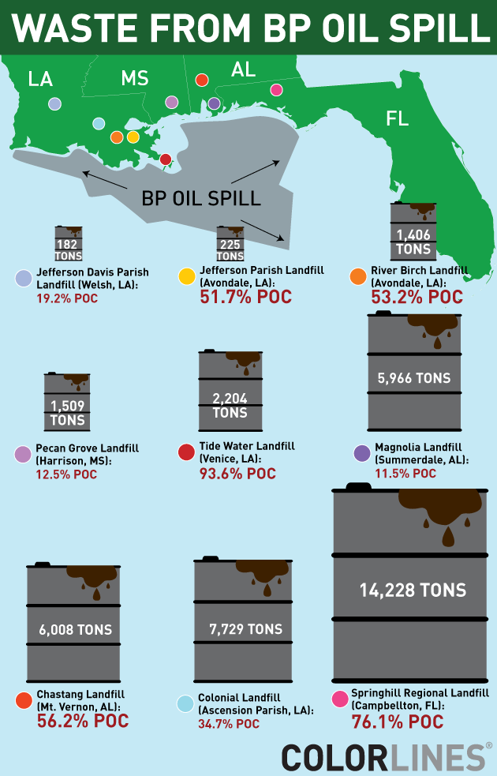
% Minority (“people of color”) for each state (as of 2008), just to provide some context:
  LA: 38.1%
  MS: 41.3%
  AL: 31.6%
  FL: 39.7%
This map shows the location of the landfills, the amount of waste (which includes “oily solids,” waste from the cleanup, and so on) sent there, and the percentage of people living within a 1-mile radius that are People of Color.

Slide 29
Negative externalities of profit-maximizing firms

Slide 30
CENTRAL PROPOSITION:
For capitalist firms pollution is not just an “accident”: In general, the most profitable economic strategies will be the most polluting because they successfully displace costs on others.
Notes:
Examples of firm negative externalities:
Nitrogen fertilizer run-off from farms
Love canal
Is this rare? Is this something that just happened in the past when we did not know better?
No: In Wisconsin as in most of the country there is a serious problem of ground water contamination with toxins from pesticides and herbicides as well as industrial waste. Solid research has demonstrated effects on birth defects, cancer, and other human harms.
• Solution = public regulation, laws and enforcement mechanisms, against displacing costs. There are many specific forms that this can take, but it always involves some kind of explicit intervention into the spontaneous behavior of people in markets.

Slide 31
Love Canal Story
10 minutes: https://www.youtube.com/watch?v=PrzqFPego4A
22 minutes: https://www.youtube.com/watch?v=VrWtd1P-NoU

Slide 32
Strategies of powerful actors

Slide 33
Total subsidies for energy from the U.S. government 1950-2006 = over $700 billion
      50% for oil & natural gas
      13% for coal
      11% for hydroelectric
      9% for nuclear
      6% for wind and solar

Slide 34
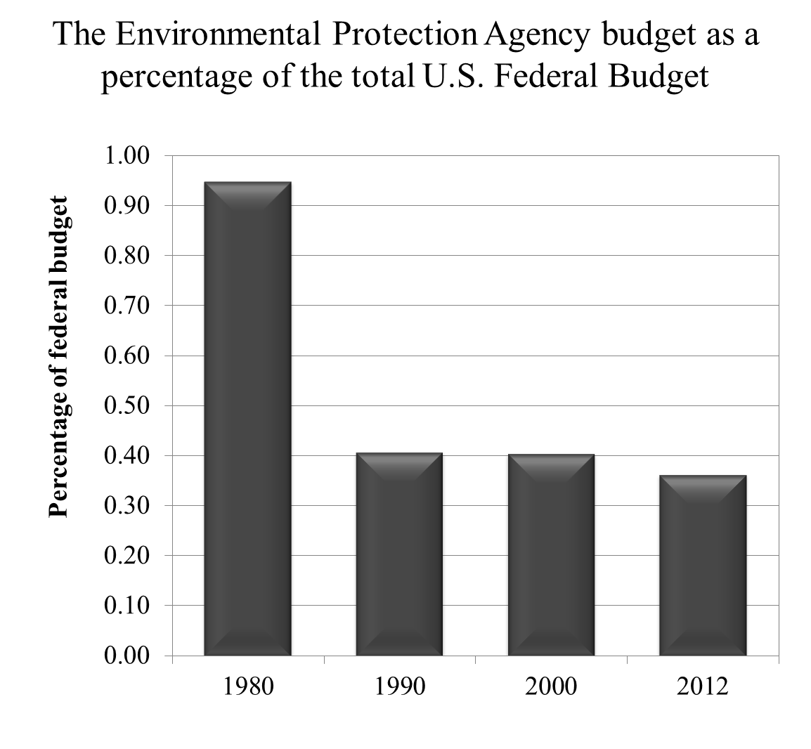

Slide 35
IV. Consumerism run amok
Notes:
1. Consumption over leisure bias: This is something we will discuss in the lecture on consumerism. Capitalist economies have a number of biases in the way decisions get made which mean that increases in productivity generally to greater consumption rather than greater leisure, greater free time. The irony in the US: as we have become richer our free time goes down, not up. This ecologically disastrous: a permanent growth in consumption is a recipe for environmental devastation: this is not sustainable forever.
2. Underpricing of natural resources in the price of consumption
The prices of commodities do not reflect the true environmental costs of their production and use. The result is that commodities that embody natural resources are cheaper than they should be: their prices do not reflect their true long term “costs of production”, and thus we consume more of these commodities than we should. The true costs of producing a car, for example, should include all of the environmental costs associated with its production. These were internalized into the price, cars would cost much more and fewer would be bought.

Slide 36
V. Free market ideology blocks solutions.

Slide 37
Key Idea
Excessive faith in the market prevents robust government intervention to:
  1. Solve environmental free-rider problems
  2. Neutralize negative externalities
  3. Block the power of corporate actors

Slide 38
GLOBAL WARMING

Slide 39
Social processes underlying climate change and obstructing solutions
Hyper-consumerism
Collective action failure among governments
Negative externalities
NIMBY movements concerning clean energy
Power and climate denial
Notes:
2. Difficulty of inter-state collective action: Rich countries need to take the lead unilaterally
3. Negative externalities: (1) the parts of the world that did not cause the problem will suffer the most: massive environmental injustice; (2) short time horizons: make future generations pay for the costs
4. NIMBY: opposition to wind turbines
5. Concentations of power:
Huge stakes: trillions of dollars of wealth would be lost to those who own property rights in fossil fuels.
solution: sowing misinformation, created pseudo-scientific controversy where none really exists. This is what the Tobacco industry did in the 1950s and 1960s.
Conservative think tanks have recruited ideologically conservative scientists to challenge the scientific evidence about climate change and create the false impression that among climate scientists there is serious controversy on the core issues
Rick Perry, Governor of Texas (and heavily supported by the oil and gas industry) dismissed scientists by saying “there are a substantial number of scientists who have manipulated data so that they will have dollars rolling into their projects.” Is this really a plausible account for why 97% of climate scientists support the anthropocentric view of global warming?

Slide 40
GLOBAL WARMING: Solutions?
Dramatically increase the costs of carbon emissions through carbon taxes in various forms (e.g. “cap-and-trade”)
Significantly expand public investment in clean energy: accelerate the transition
Massive public funding for research in energy alternatives
Expansion of public transport. Free public transit?
Subsidized energy efficiency retrofitting of buildings
The biggest challenge: Shift towards a society less oriented to ever-expanding material consumption.

Slide 41
Implication
All of these solutions require a reinvigorated democratic affirmative state

Slide 42
1987 TV Public Service Ad Against Pollution
http://www.youtube.com/watch?v=hwYDyRKmxZc&feature=related

Slide 43
Lois Gibbs account of her Love Canal experience
http://www.youtube.com/watch?v=PrzqFPego4A

